Slide 1
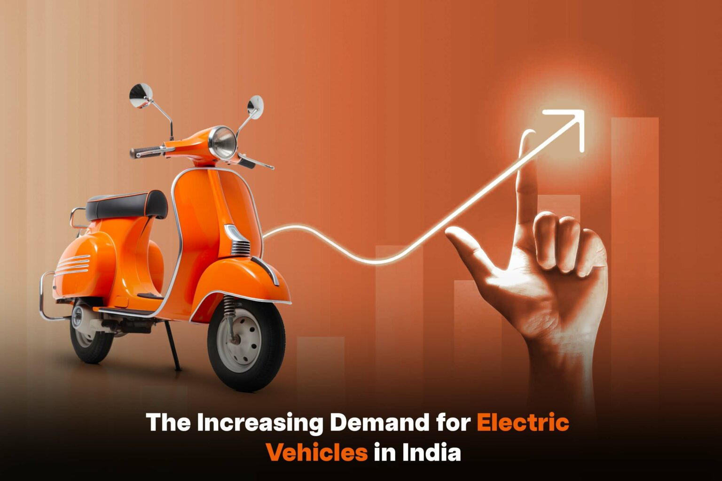
AtliQ Motors EV Sales
APURVA BHALERAO

Slide 2
Objective:
AtliQ Motors is an automotive giant from the USA specializing in electric vehicles (EV). In the last 5 years, their market share rose to 25% in electric and hybrid vehicles segment in North America. As a part of their expansion plans, they wanted to launch their bestselling models in India where their market share is less than 2%. Bruce Haryali, the chief of AtliQ Motors India wanted to do a detailed market study of existing EV/Hybrid market in India before proceeding further. Bruce gave this task to the data analytics team of AtliQ motors and Peter Pandey is the data analyst working in this team.

Slide 3
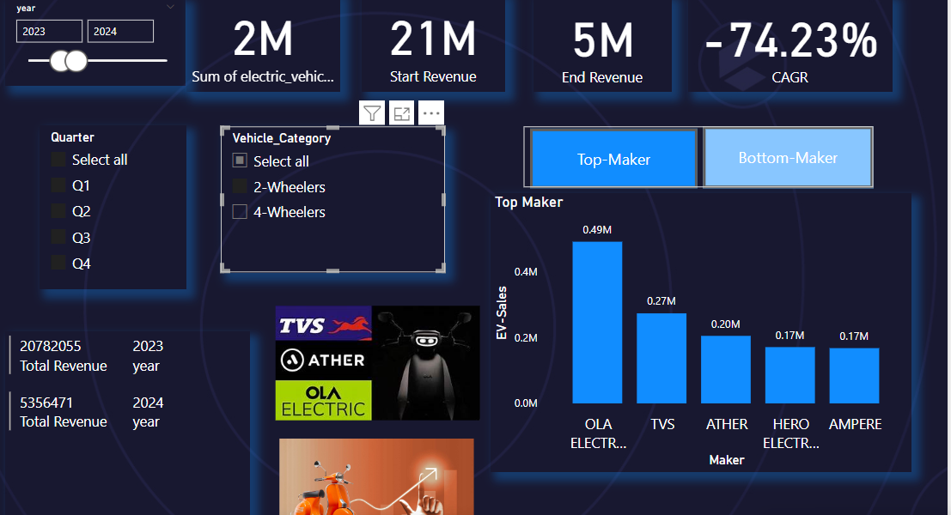
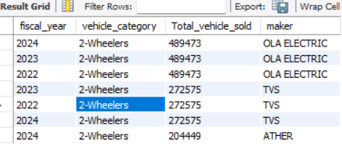
List the top 3 and bottom 3 makers for the fiscal years 2023 and 2024 in terms of the number of 2-wheelers sold
Top Maker: 1.Ola Electric 2.TVS 3.Ather

Slide 4
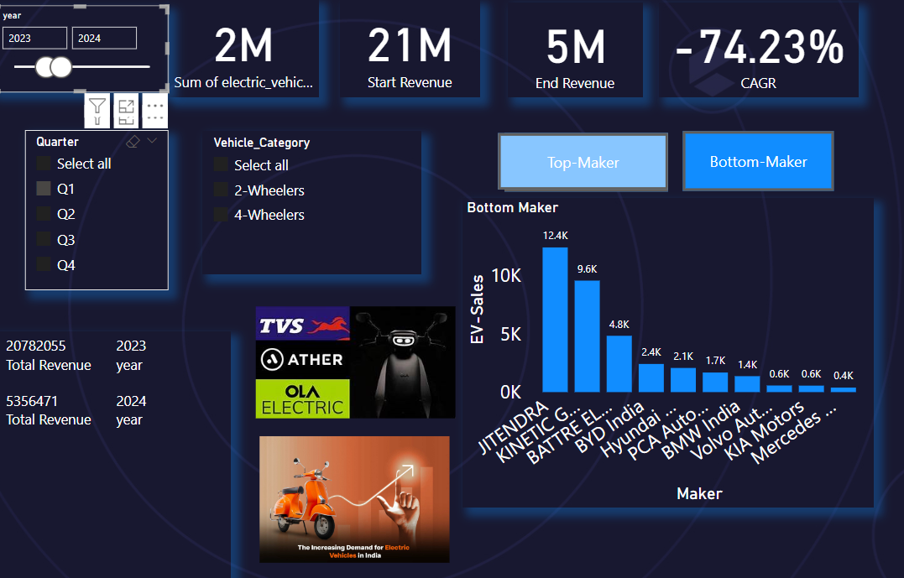
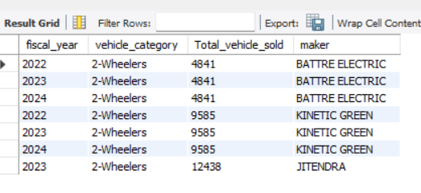
Bottom Maker: 1.Battery Electric 2.Kinetic Green 3.Jitendra

Slide 5
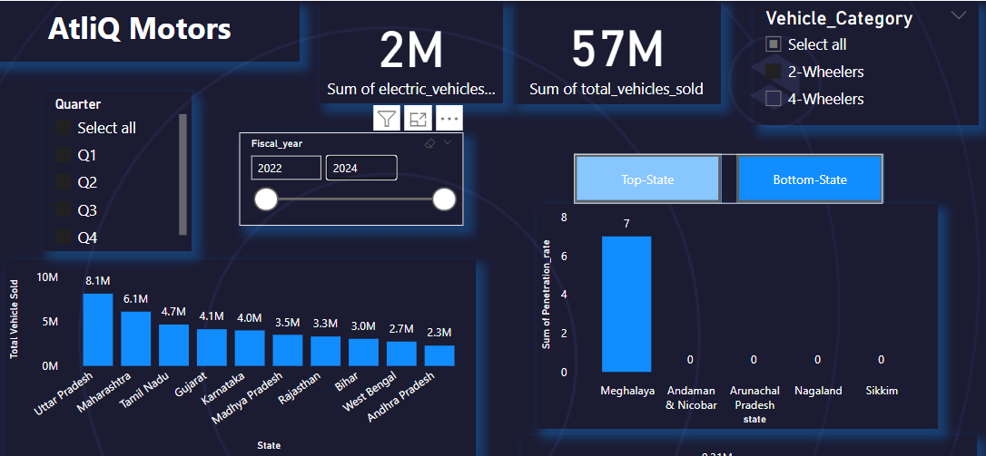
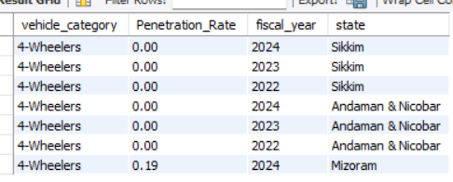
List the states with negative penetration (decline) in EV sales from 2022 to 2024?
Sikkim Andaman And Nikobar
Mizoram

Slide 6
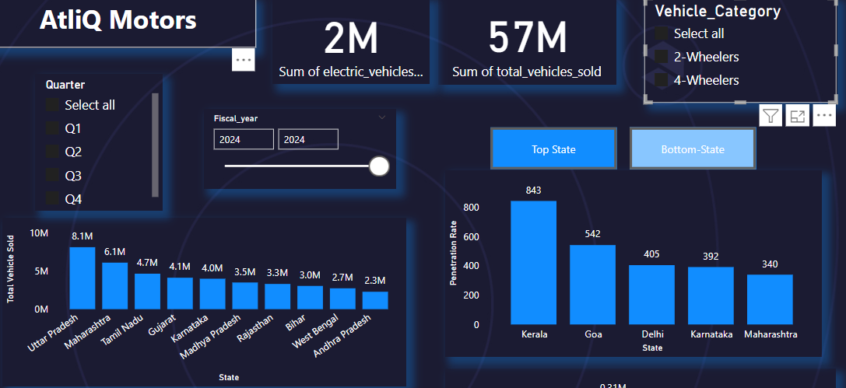
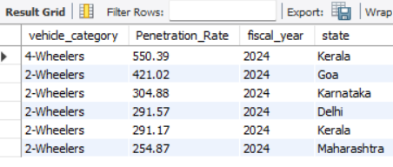
Identify the top 5 states with the highest penetration rate in 2-wheeler and 4-wheeler EV sales in FY 2024.
Kerala Goa Delhi Karnataka Maharashtra

Slide 7
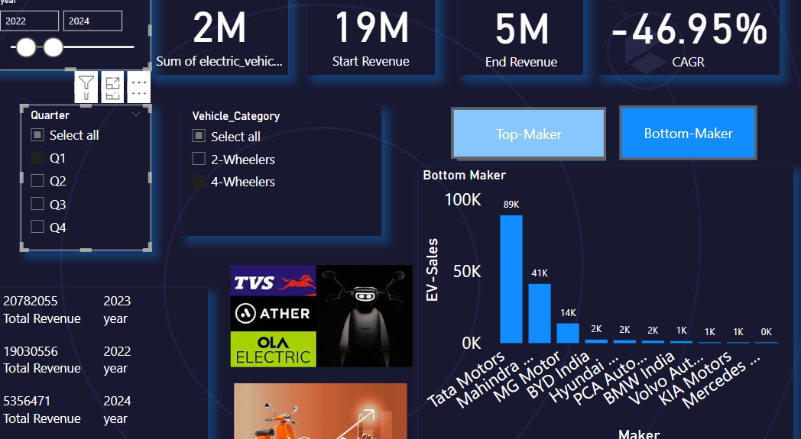
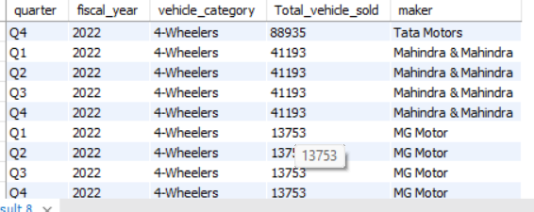
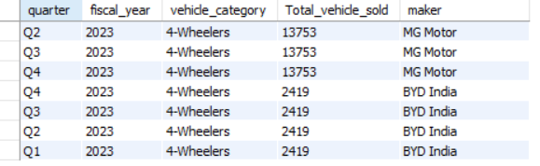
What are the quarterly trends based on sales volume for the top 5 EV makers (4-wheelers) from 2022 to 2024
Tata Motors Mahindra and Mahindra MG Motors BYD Hyudai

Slide 8
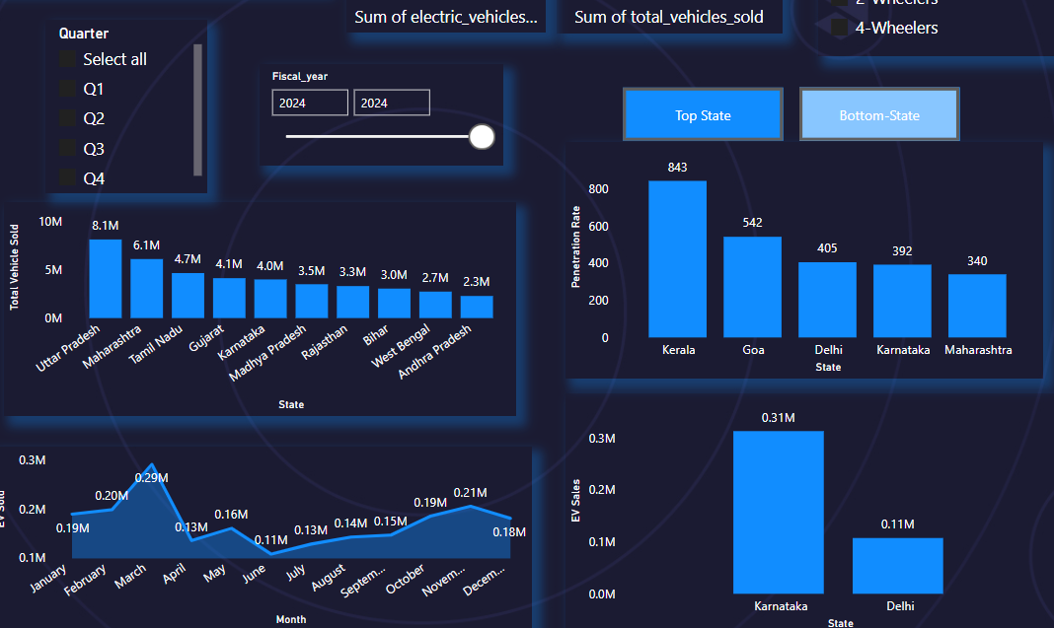
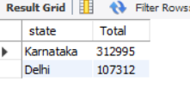
How do the EV sales and penetration rates in Delhi compare to Karnataka for 2024?
Karnataka has highest Penetration compare to Delhi.

Slide 9
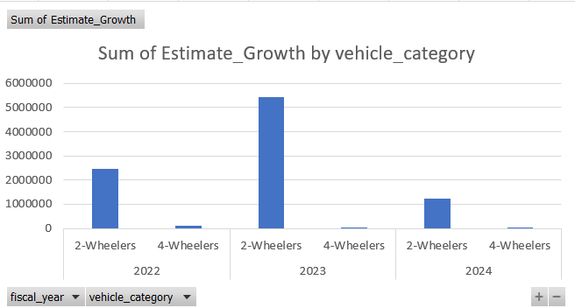
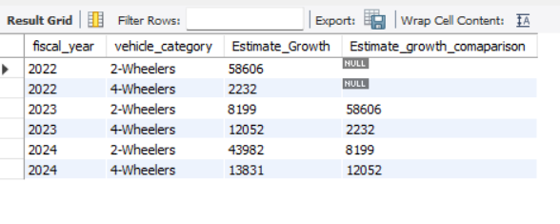
Estimate the revenue growth rate of 4-wheeler and 2-wheelers EVs in India for 2022 vs 2024 and 2023 vs 2024, assuming an average unit price. H

Slide 10
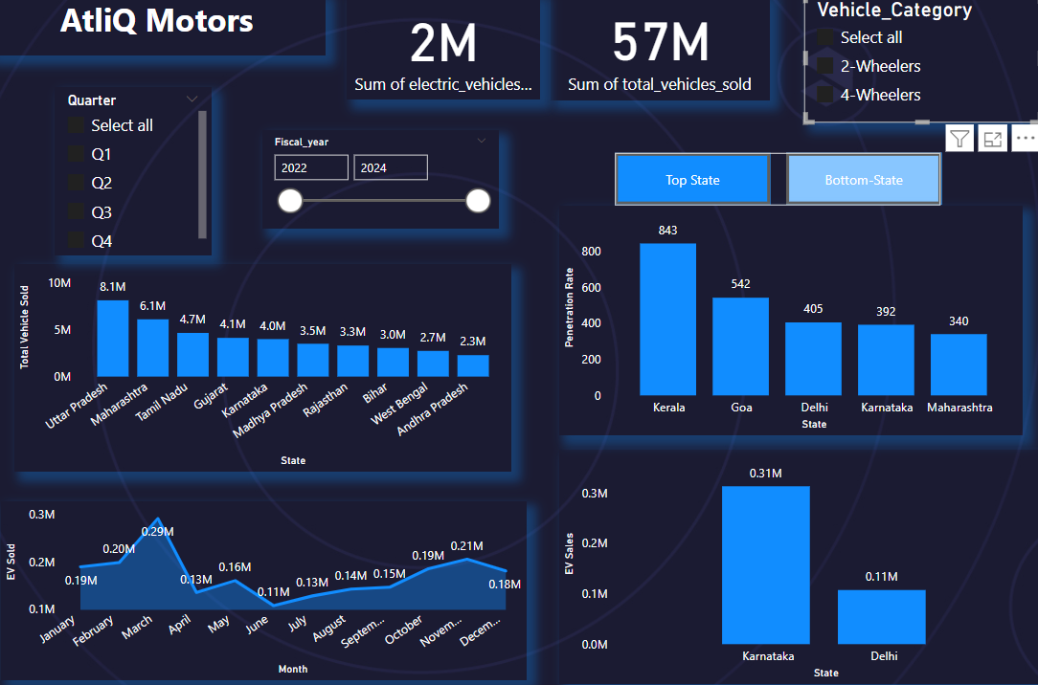

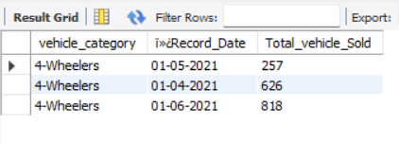
8. What are the peak and low season months for EV sales based on the data from 2022 to 2024 Peak month:
Peak Season : March is the peak Month for EV Sales low Season: April to June Months for EV sales

Slide 11
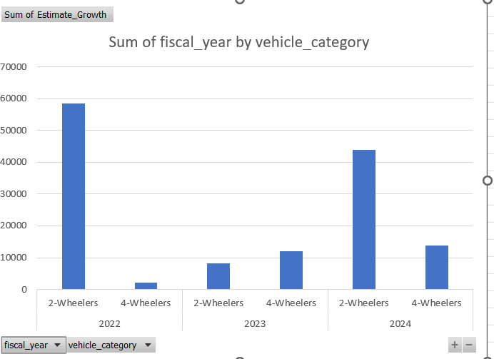
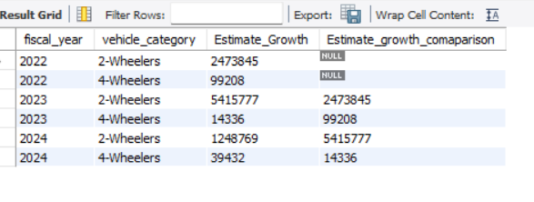
Estimate the revenue growth rate of 4-wheeler and 2-wheelers EVs in India for 2022 vs 2024 and 2023 vs 2024, assuming an average unit price.

Slide 12
1. What are the primary reasons for customers choosing 4-wheeler EVs in 2023 and 2024 (cost savings, environmental concerns, government incentives)?
Environmental Concerns:
The Environmental benefits of electric vehicles helps to make cities cleaner and healthier because they don't produce as much pollution as regular vehicles.
Government Incentives:
The Indian government has taken steps like giving discounts, tax breaks, and money back to encourage people to choose the best electric scooter in India.
Rising Fuel Costs:
Fuel prices have been rising steadily, which has forced people to look for more affordable options. As a result, demand for electric vehicles in India has increased rapidly. When compared to their fossil fuel alternatives, electric bikes and scooters provide a more cost-effective form of transportation due to their considerably lower operating expenses.

Slide 13
EV technology advancements:
The fast progress in making electric vehicles better, especially in how long their batteries last and how far they can go, has made people more sure about buying them. They work better, there are many places to charge them up on the go, and they also have cool new things that make them even better. That's why more people want to buy electric vehicles as their main way to get around.

Slide 14
Charging Infrastructure Development:
The EV charging infrastructure development and expansion across the country has been pivotal in driving the demand for electric vehicles in India. With the establishment of charging stations in urban centers and along major highways, range anxiety is alleviated, making electric scooters and bikes a practical choice for daily commuting and long-distance travel.
Advocacy and Awareness Campaigns:
Efforts to make people aware and advocate for electric vehicles have been really important in shaping what people think. Campaigns and educational programs that talk about how electric scooters are good for the environment and can save money have helped many people who care about the environment.
Innovative Government Policies:
Smart government strategies that support the EV market growth factors and have fostered a favorable environment for the electric vehicle market in India, thus fueling the demand for electric vehicles in India. Policies like rewards for companies making electric vehicles, financial aid for buyers, and requirements for using electric vehicles in public transport have encouraged investment and advancements in the EV industry outlook.

Slide 15
4. Who should be the brand ambassador if AtliQ Motors launches their EV/Hybrid vehicles in India and why
Ratan Tata:Ratan Tata is an inspiration because he is a self-made man who has achieved great success. He is a role model for young entrepreneurs and a source of pride for India.
Virat Kohli : He is truly inspiration for all young age group.

Slide 16
5. Which state of India is ideal to start the manufacturing unit? (Based on subsidies provided, ease of doing business, stability in governance etc.)
Maharshtra:
Decrypting the Maharashtra EV Policy:
Demand-side incentives: The policy offers attractive subsidies to EV buyers. Individuals and private companies can avail of benefits like:
Subsidy:All electric vehicles purchased and registered in Maharashtra are eligible for a 15% subsidy, capped at:
Rs. 5,000 for two-wheelers
Rs. 12,000 for three-wheelers
Rs. 1 lakh for four-wheelers (with additional incentives for the first 10,000 buyers)
Exemption from road tax and registration fees for all EVs
Scrapping incentive: To encourage the replacement of old, polluting vehicles, the policy offers a scrappage incentive of:
Up to Rs. 7,000 for two-wheelers
Up to Rs. 25,000 for four-wheelers
Focus on manufacturing: The policy also aims to boost EV manufacturing within Maharashtra by incentivising Original Equipment Manufacturers (OEMs).

Slide 17
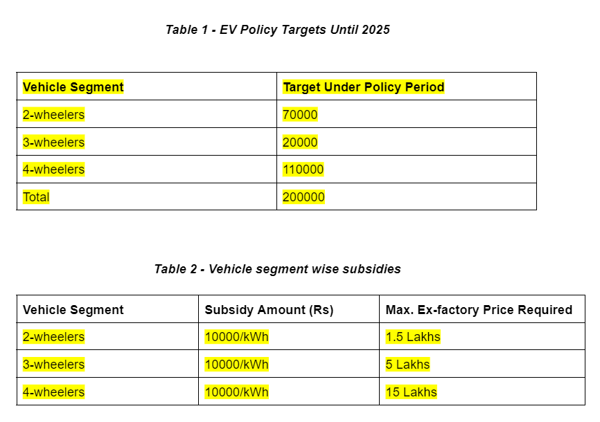
2.Gujrat: The Gujarat EV Policy plans to establish a robust EV charging infrastructure in addition to electric automobiles. To do this, the policy stipulated a 25% capital subsidy on gear and technology for the responsibility of business Charging infrastructure for two-wheelers, three-wheelers, and four-wheelers, up to a maximum of Rs. 10 lakh. First, 250 commercial, public EV charging stations will use this. Additionally, for the duration of the policy, the Gujarati government declared a 100% exemption from power duty for EV charging stations. Additionally, it was announced that, except for the farm connection, State Distribution Licensees (DisComs) would permit the charging of EVs from an existing consumer connection at the current rate.

Slide 18
Your top 3 recommendations for AtliQ Motors
My recommendations is Maharshtra,Gujrat states of India is ideal to start the manufacturing unit (Based on subsidies provided, ease of doing business, stability in governance )
Brand ambassador should be Ratan Tata,Virat Kohli.
Based peak Month is March so according to that you can start launch EV.

